Slide 1
Welcome All Student
Class will be start at sharp 10.05 am

Slide 2
Welcome to OOPs Java Workshop
By
Harikrashna Parikh
Team CodeOnly

Slide 3
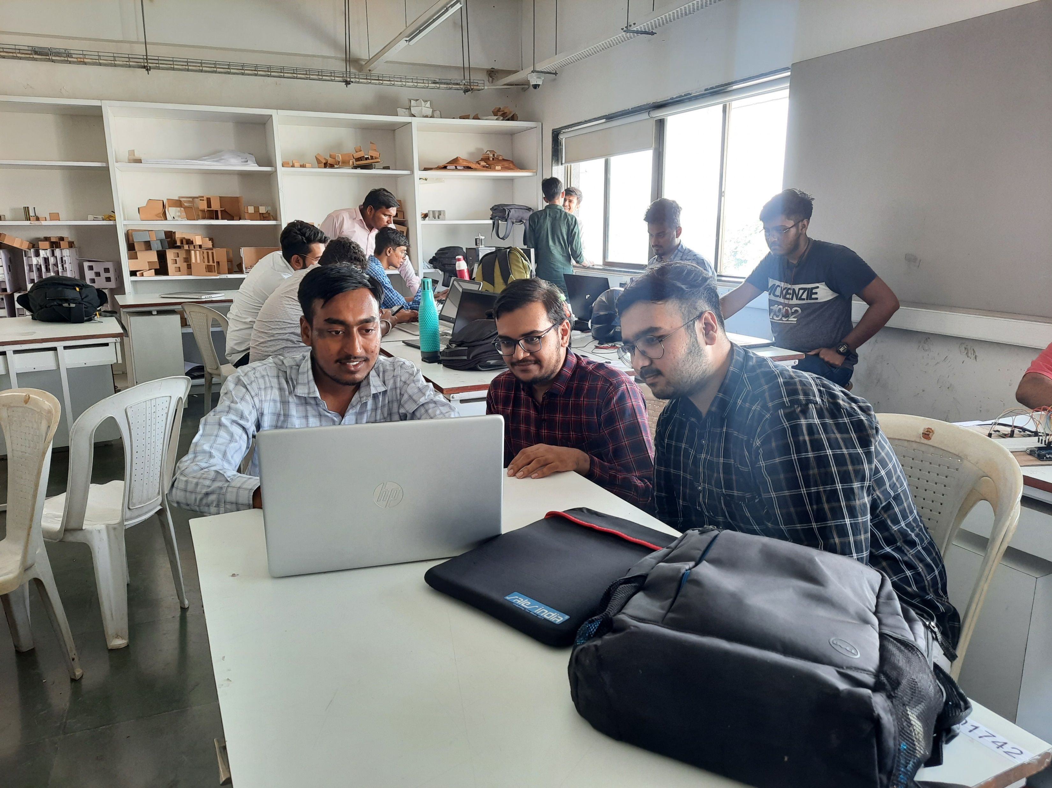
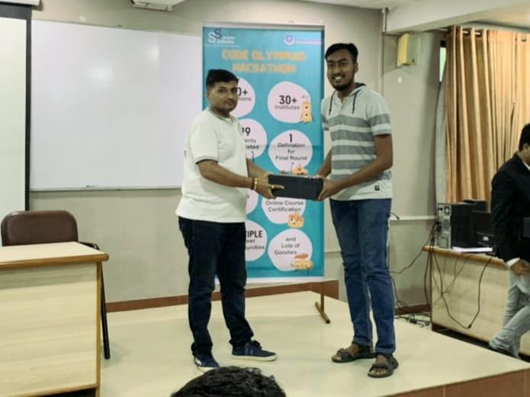
About Us
Team CodeOnly
A team who love to code and to teach that codes !
I am Harikrashna Parikh
Final Year student at LJ College | Current CGPA = 9.13/10 | SPI = 9.39/10
Participated and also win the different Hackathons

Slide 4
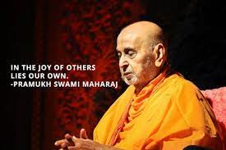

Why Started this initiative for free ?
Inspired by College 1st year Workshop and phoenix club

Slide 5


Why you should Learn Java ?
All time best and easy to learn and explore
Placement Scenario for freshers
Basketball Story : The hoop

Slide 6
Introduction to Java Language
General-purpose high level programming language
Object-oriented language
Class-based
It has a large demand in the current job market
Robust and Secured

Slide 7
It’s Applications :
Mobile applications (specially Android apps)
Desktop applications
Web applications
Web servers and application servers
Games
Database connection
And much, much more!

Slide 8
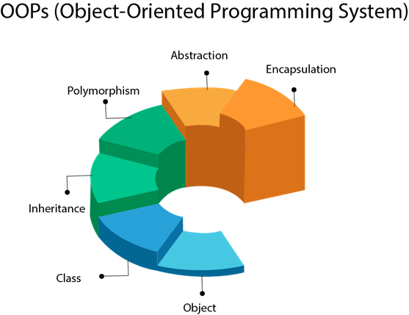
What is OOPs concept ?
Class
Object
Inheritance
Polymorphism
Encapsulation
Abstraction

Slide 9
What is Object
Instance of Class
Any Entity that has State and behaviour
Can You tell me any real world example of object ?

Slide 10
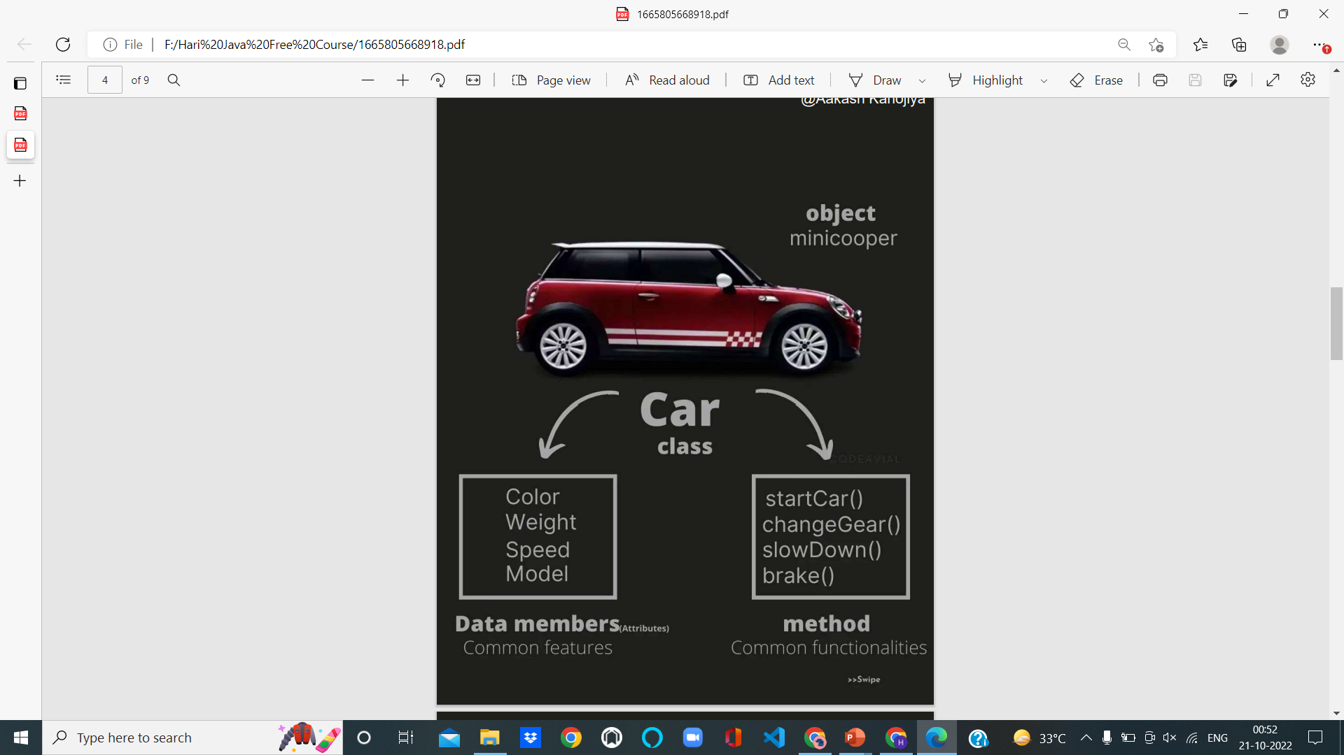
Real World Example of Object

Slide 11
What is Class
Blue Print of Object
Collection of object is called class
It is a logical entity
Can You tell me any real world example of object ?

Slide 12
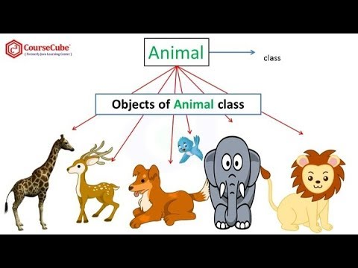
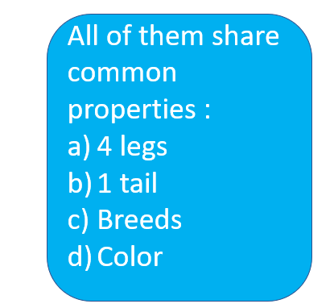
Real World Example of Class

Slide 13
Download Java
VS Code Live
How to start in VS code Java Live

Slide 14
Feature of Java
Simple
Free from pointer memory allocation, so Execution time improved
Garbage Collector in java → use to collect unreferenced (Unused) memory location
Platform Independent
A platform is the hardware and software environment in which a program runs.
Once compiled, java code runs on any platform without recompiling on any kind of modification.

Slide 15
Feature of Java
Distributed
Java is distributed because it facilitates users to create distributed applications in Java. RMI and EJB are used for creating distributed applications. This feature of Java makes us able to access files by calling the methods from any machine on the internet.

Slide 16
Variables in Java
Example of variable like length, breadth, total, total_hight, finalTotal
Rule or condition for Variables
* Variable must not begin with a digit.
* Variable are Case Sensitive it means uppercase and lowercase are distinct.
* Should not be keyword
* White space not allowed
* Variable length can be of any length

Slide 17
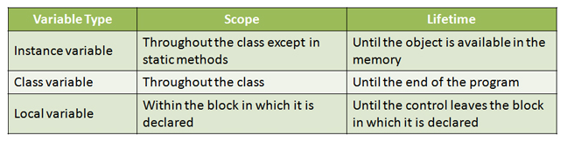
Scope Of Class
Instance Variable
Class variable
Local variables

Slide 18
Data Types
Every Variable in java has a Data type. Data types Specify the Size and type of values that can be stored.

Slide 19
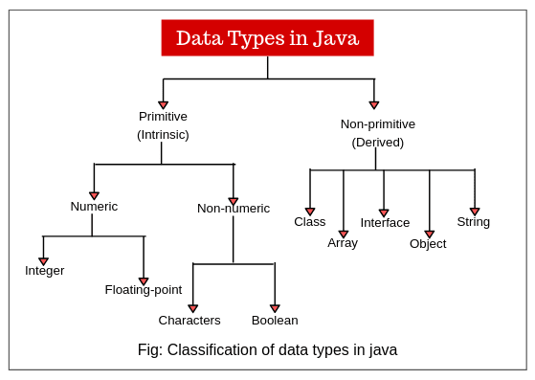

Slide 20
Data Types
Data Type | Size | Description
byte | 1 byte | Stores whole numbers from -128 to 127
short | 2 bytes | Stores whole numbers from -32,768 to 32,767
int | 4 bytes | Stores whole numbers from -2,147,483,648 to 2,147,483,647
long | 8 bytes | Stores whole numbers from -9,223,372,036,854,775,808 to 9,223,372,036,854,775,807
float | 4 bytes | Stores fractional numbers. Sufficient for storing 6 to 7 decimal digits
double | 8 bytes | Stores fractional numbers. Sufficient for storing 15 decimal digits
boolean | 1 bit | Stores true or false values
char | 2 bytes | Stores a single character/letter or ASCII values

Slide 21
Take Input from user
Download Package :
import java.util.Scanner;
Then
Scanner s=new Scanner(System.in);
Other Method for taking an input
Use System.Console.class
Or use BufferReader class

Slide 22
Operators
Unary Operator
Arithmetic Operator
Shift Operator
Relational Operator
Bitwise Operator
Logical Operator
Ternary Operator
Assignment Operator

Slide 23
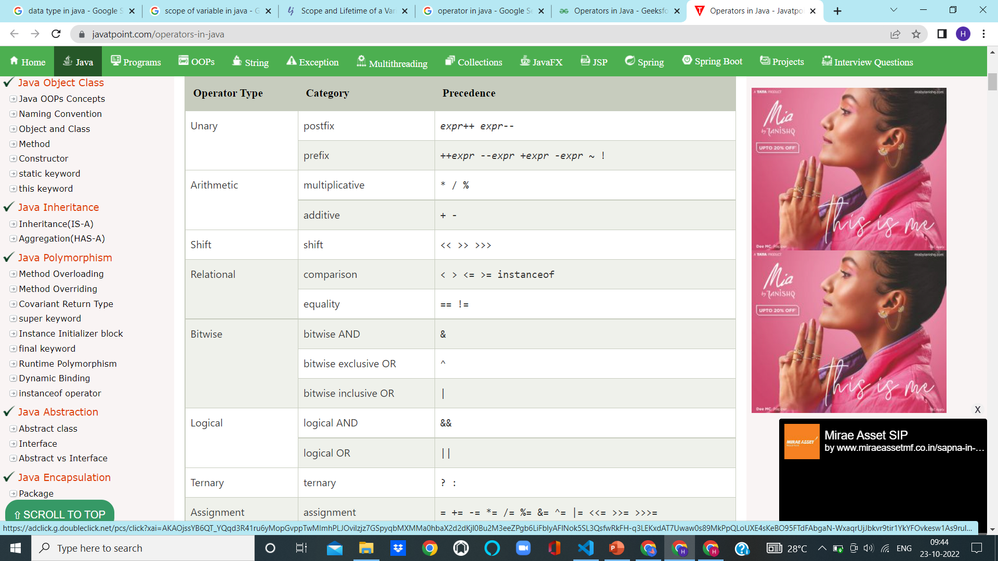

Slide 24
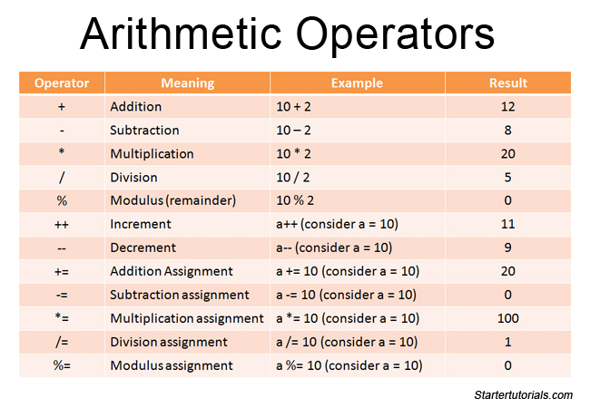
Arithmetic Operator Find The Output Of below expressions

Slide 25
Control Statements
1. Decision Making Statement /Conditional Control Statements
If Statements
Switch Statements
2. Loop Statements
For loop
While loop, Do While Loop
3. Jump Statements / Unconditional statements
Break and Continue Statements

Slide 26
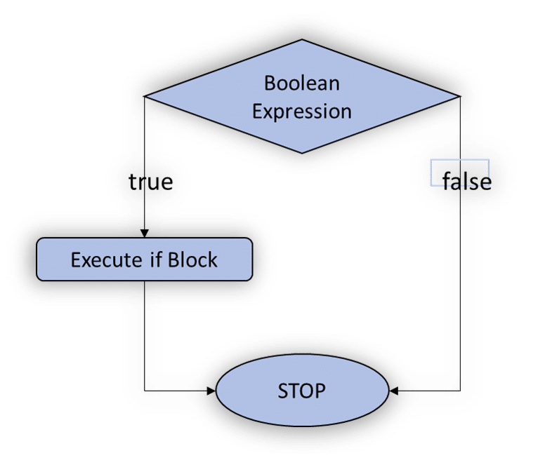
Conditional Control Statements
If Statement :
It will go inside the block only if the condition is true , otherwise, it will not execute the block.
Syntax :
if(condition)
{ // statements (if Block) }

Slide 27
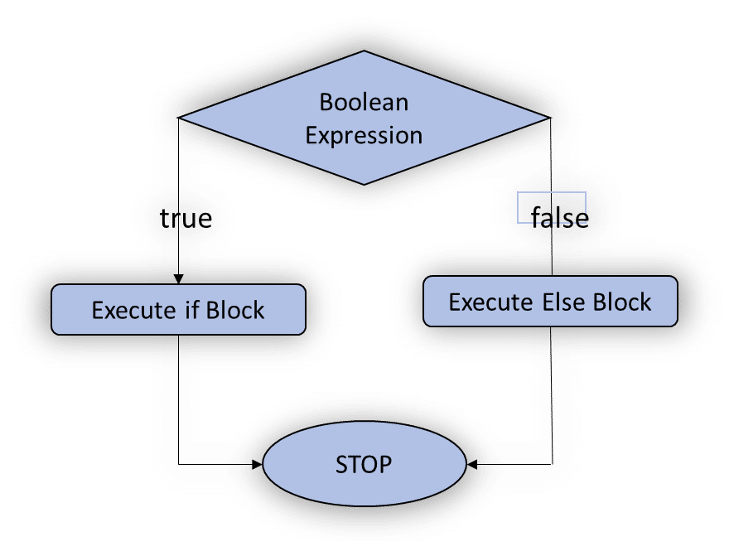
Conditional Control Statements
2. If – Else Statements :
If the condition is true then, it will execute the If block. Otherwise, it will execute the Else block.
Syntax :
if(condition)
{ // statements (if Block) } else
{ // statements (Else block) }

Slide 28
Conditional Control Statements
3. If else if ladder:
If the condition is true, then it will execute the If block. Otherwise, it will execute the Else-If block. Again, if the condition is not met, then it will move to the else block.
Syntax :
If(condition)
{ } else if
{ } else
{ }

Slide 29
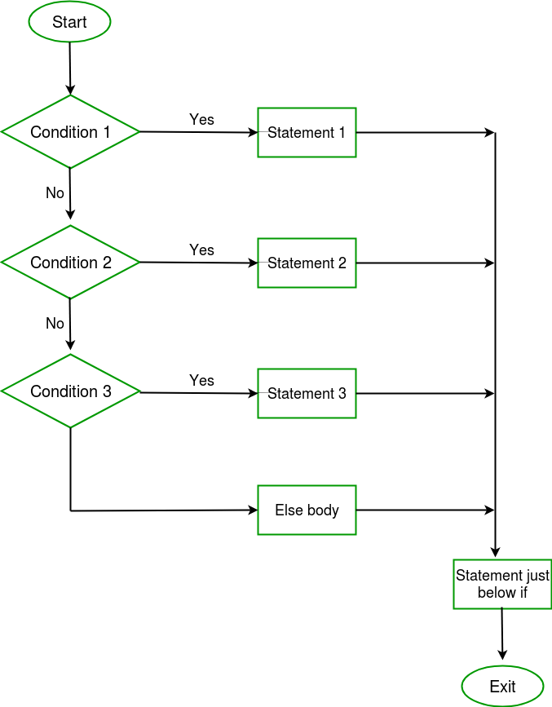
Else If Ladder
Code example Live

Slide 30
Nested if Statement
In nested if-statements, the if statement can contain a if or if-else statement inside another if or else-if statement.
Syntax :
if(condition 1) {
if(condition 2) {
statement 2;
}
else{
statement 2;
}
}

Slide 31
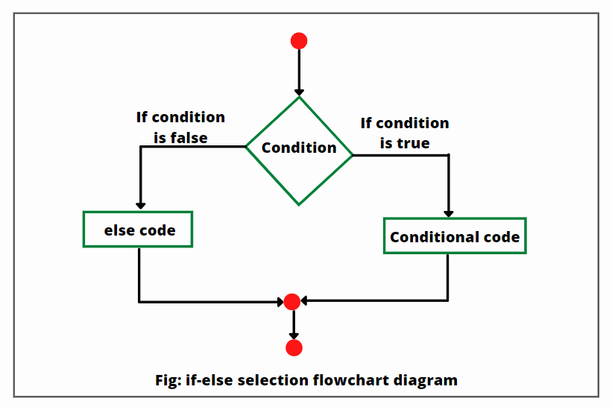
Nested If else Statement

Slide 32
Switch Statement
The switch statement contains multiple blocks of code called cases and a single case is executed based on the variable which is being switched. The switch statement is easier to use instead of if-else-if statements. It also enhances the readability of the program.

Slide 33
Switch Statement
switch (expression)
{
case value1:
statement1;
break;
.
.
.
.
case valueN:
statementN;
break;
default:
default statement;
}
Live Example with Calculator

Slide 34
Loop Statement :- For Loop
In Java, It enables us to initialize the loop variable, check the condition, and increment/decrement in a single line of code. We use the for loop only when we exactly know the number of times, we want to execute the block of code.
Syntax :
for(initialization, condition, increment/decrement)
{
//block of statements
}

Slide 35
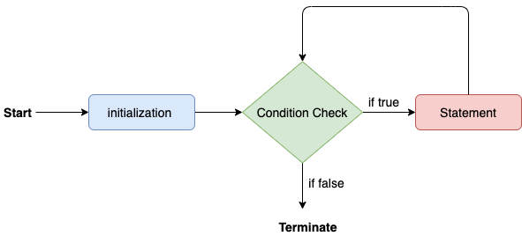
For Loop

Slide 36
While Loop
The while loop is also used to iterate over the number of statements multiple times. However, if we don't know the number of iterations in advance, it is recommended to use a while loop. Unlike for loop, the initialization and increment/decrement doesn't take place inside the loop statement in while loop.
Syntax :
while(condition)
{
//looping statements
}

Slide 37
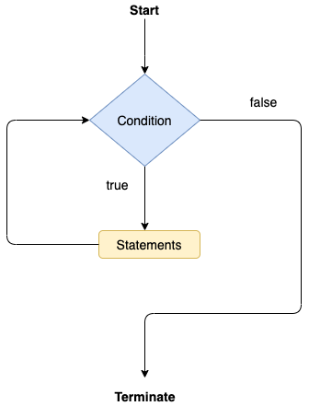
While Loop

Slide 38
Do while loop
The do-while loop checks the condition at the end of the loop after executing the loop statements. When the number of iteration is not known and we have to execute the loop at least once, we can use do-while loop.
Syntax :
do
{
//statements
} while (condition);

Slide 39
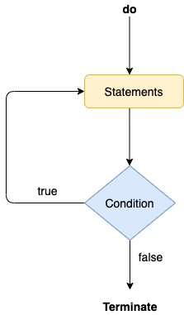
Do while Loop

Slide 40
Jump Statement - break
The break statement is used to break the current flow of the program and transfer the control to the next statement outside a loop or switch statement. However, it breaks only the inner loop in the case of the nested loop.
Live example - code

Slide 41
Continue statement
Unlike break statement, the continue statement doesn't break the loop, whereas, it skips the specific part of the loop and jumps to the next iteration of the loop immediately.
Live Example by Code

Slide 42
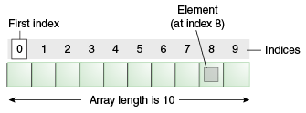
Array in Java
An array is a collection of similar type of elements which has contiguous memory location.

Slide 43
Array
Advantage :
Code Optimization: It makes the code optimized, we can retrieve or sort the data efficiently.
Random access: We can get any data located at an index position.
Disadvantage :
Size Limit: We can store only the fixed size of elements in the array. It doesn’t grow its size at runtime. To solve this problem, collection framework is used in Java which grows automatically.

Slide 44
Types of Array
Single Dimensional Array
Multidimensional Array
Single Dimensional Array :
Also called as 1D array
Syntax for Single dimension array :
dataType[] arr; (or)
datatype []arr; (or)
dataType arr[];
At the time of array declaration we can not specify the size of the array.

Slide 45
Array Creation
By using new keyword
Ex:
int a[]=new int[5];
Without using new keyword / direct method
Ex:
int a[]={10,20,30,40,50};
Length Function for array:
length : It is a final variable and only applicable for array. It represent size of array.
Example:
a.length

Slide 46
Multidimensional Array
Array Declaration
int [][]a;
int[][] a;
int[] []a;
int a[][];
int []a[];
int[] a[];
Live example
By direct method and using new keyword method

Slide 47
Matrix Addition
Live Example

Slide 48
What will we learn in String Handling?
Concept of String
Immutable String
String Comparison
String Concatenation
Concept of Substring
String class methods and its usage
StringBuffer class

Slide 49
String
Generally, String is a sequence of characters. But in Java, string is an object that represents a sequence of characters. The java.lang.String class is used to create a string object.
Java String class provides a lot of methods to perform operations on strings such as compare(), concat(), equals(), split(), length(), replace(), compareTo(), intern(), substring() etc.
String is immutable that means content can not be changed at the time of execution of program.

Slide 50
How to create String object?
By String literal
By new keyword
By String literal :-
It uses double quotes to create.
Ex:
String s=“Welcome”;
By new keyword :-
It uses new keyword to create.
Ex:
String s=new String(“Welcome”);

Slide 51
Operation on String / Methods of String
Length() :-
This Method is used to get the total numbers of character of any String.
Live example
charAt() :-
This Method is used to get the character at a given index value.
Live example

Slide 52
Operation on String / Methods of String
toUpperCase() :-
The java string toUpperCase() method returns the string in uppercase letter. In other words, it converts all characters of the string into upper case letter.
Live example
toLowerCase() :-
The java string toLowerCase() method returns the string in lowercase letter. In other words, it converts all characters of the string into lower case letter.
Live example

Slide 53
Operation on String / Methods of String
concat() :-
The Java String class concat() method combines specified string at the end of this string. It returns a combined string. It is like appending another string.
Live example

Slide 54
Operation on String / Methods of String
equals() :-
The Java String class equals() method compares the two given strings based on the content of the string. If any character is not matched, it returns false. If all characters are matched, it returns true.
Live example
equalsIgnoreCase():-
The Java String class equalsIgnoreCase() method compares the two given strings on the basis of the content of the string irrespective of the case (lower and upper) of the string.
Live example

Slide 55
Operation on String / Methods of String
compareTo() :-
This method is used to compare two strings by taking unicodes values, it returns 0, if the string are same otherwise return positive and negative integer values.
Live example
compareToIgnoreCase() :-
Similar to compareTo() method and also allows both case
Live example

Slide 56
Operation on String / Methods of String
startsWith()
endsWith()
trim()
replace()
substring()
The Java String class substring() method returns a part of the string.

Slide 57
String Buffer Class
String Buffer Class object is mutable that means when we create an object of Stringbuffer class it can be changed.
It is a predefined class in java.lang package can be used to handle the string, whose object is that means content can be modify.
Live Example

Slide 58
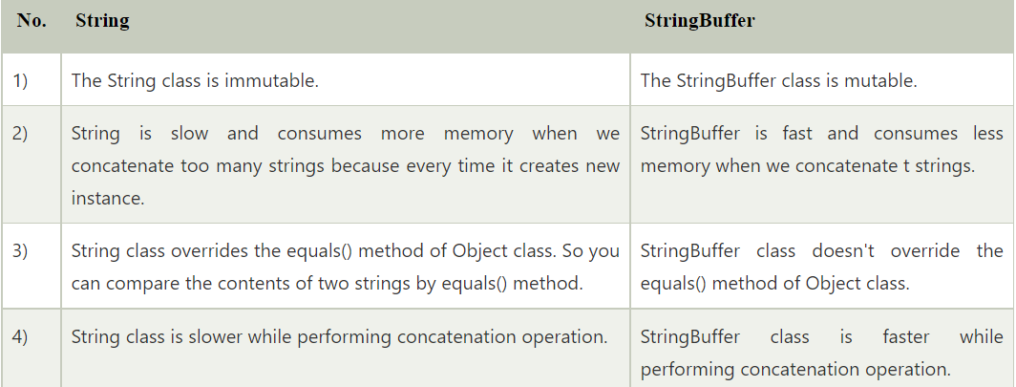
Difference : String vs String Buffer Class

Slide 59
StringBuffer Class Methods
StringBuffer Class append() Method
StringBuffer insert() Method
StringBuffer replace() Method
StringBuffer delete() Method
StringBuffer reverse() Method
Allm Live Example

Slide 60

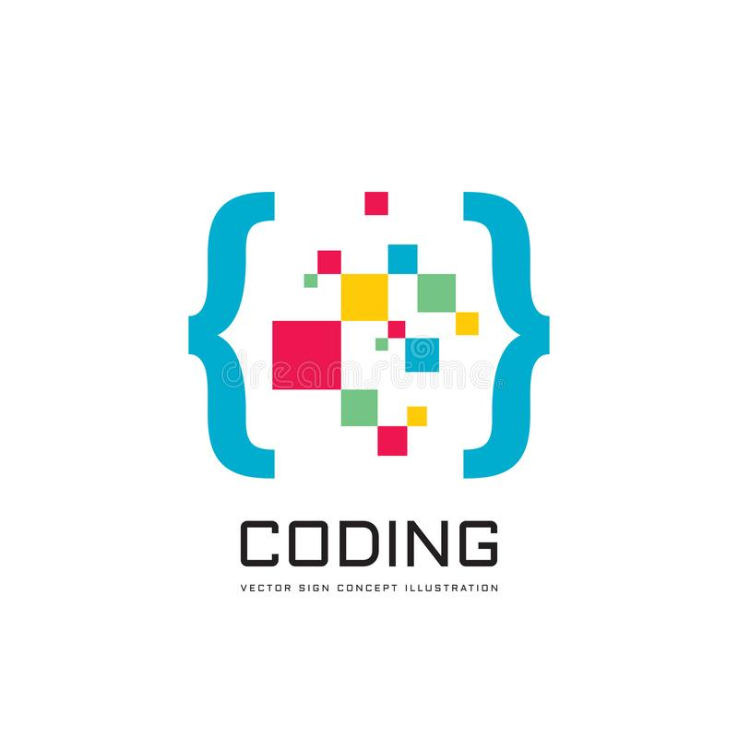
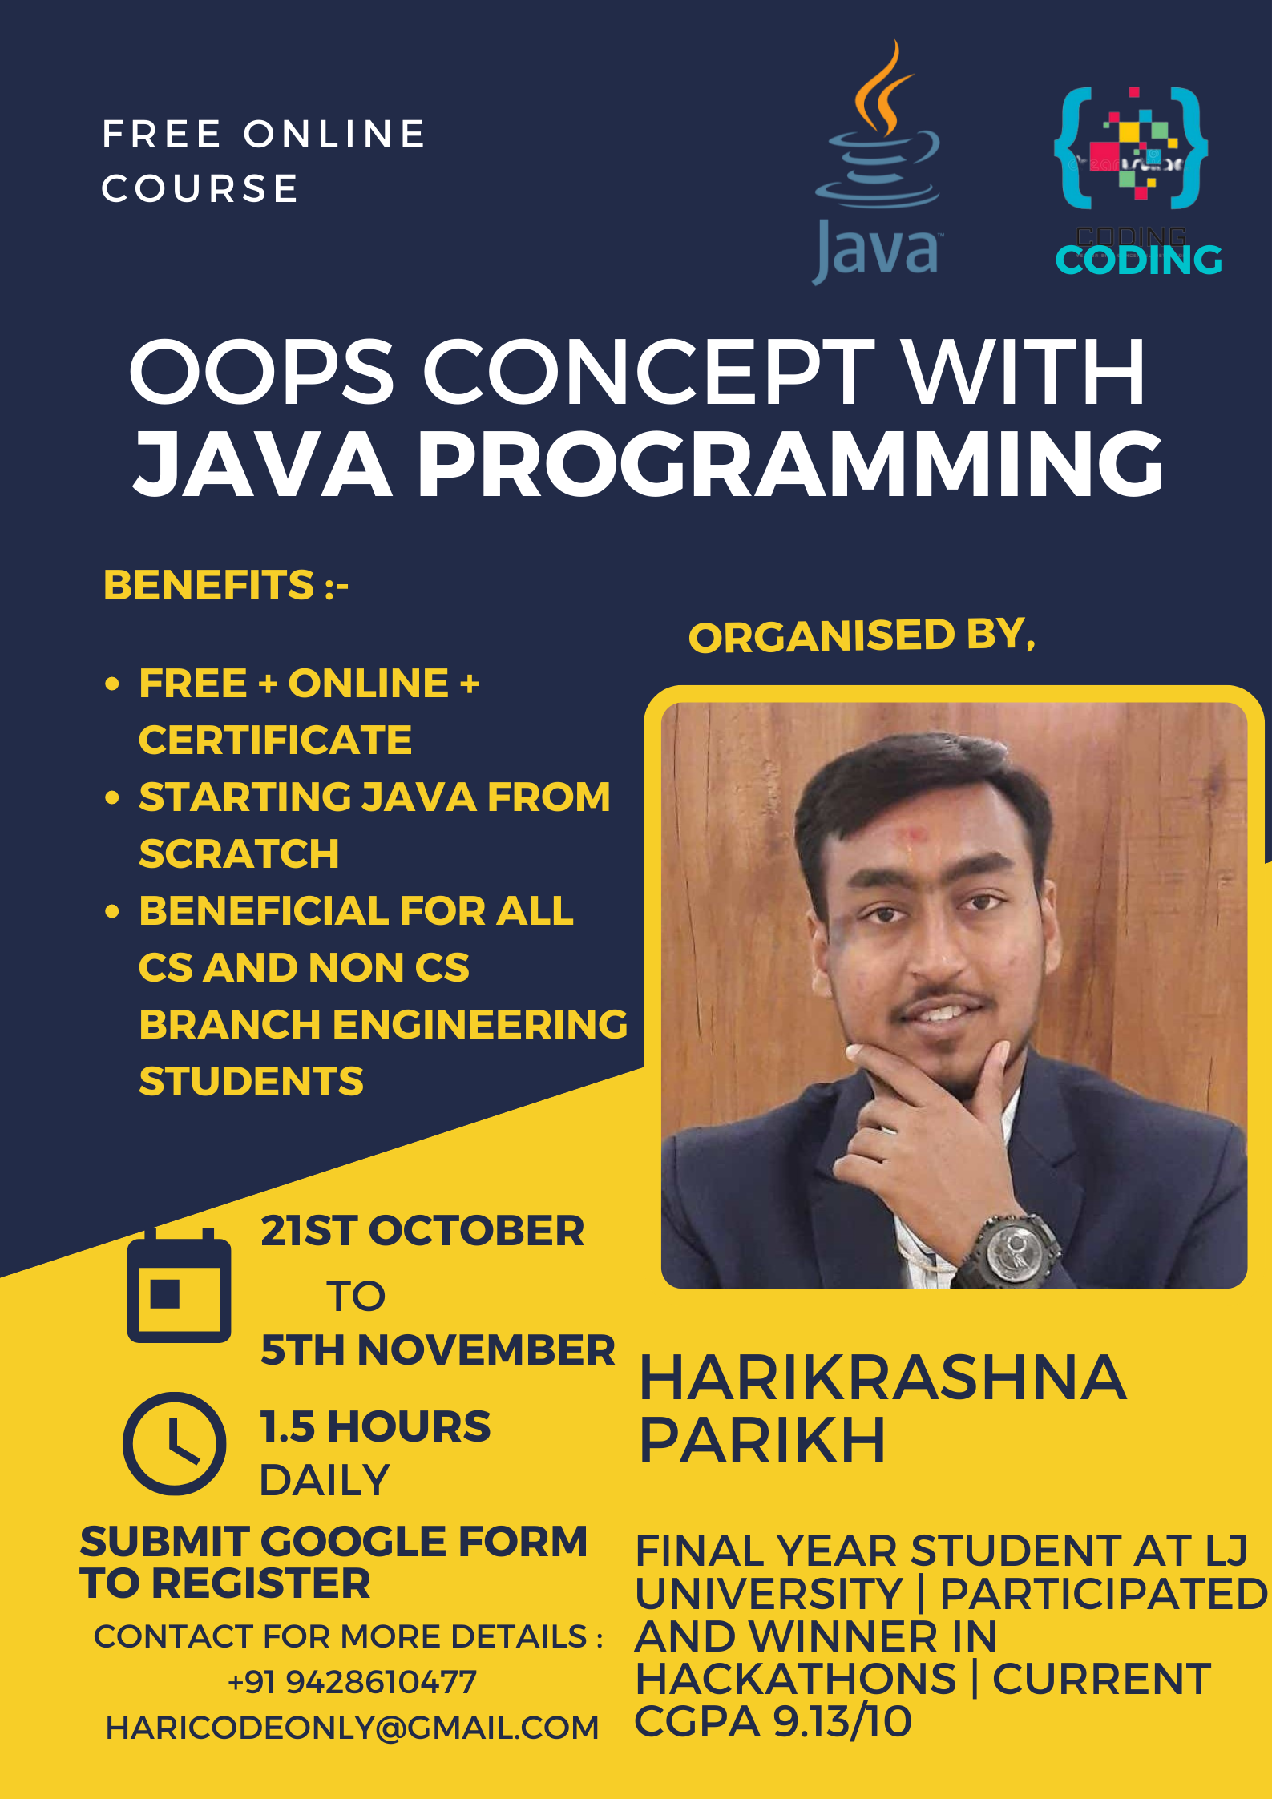




Introduction to Java
CS 331

Slide 61


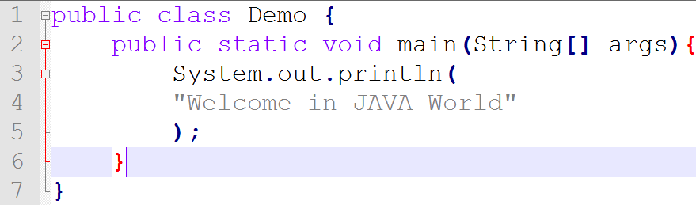
OBJECT Oriented PROGRAMMING USING JAVA (3153203) Sem-5-ICT
Introduction to Java
Unit - 1: (Basics of Java)

Slide 62
OBJECT Oriented PROGRAMMING USING JAVA Programming
Introduction to Java
Unit - 1: (Basics of Java)

